Slide 1
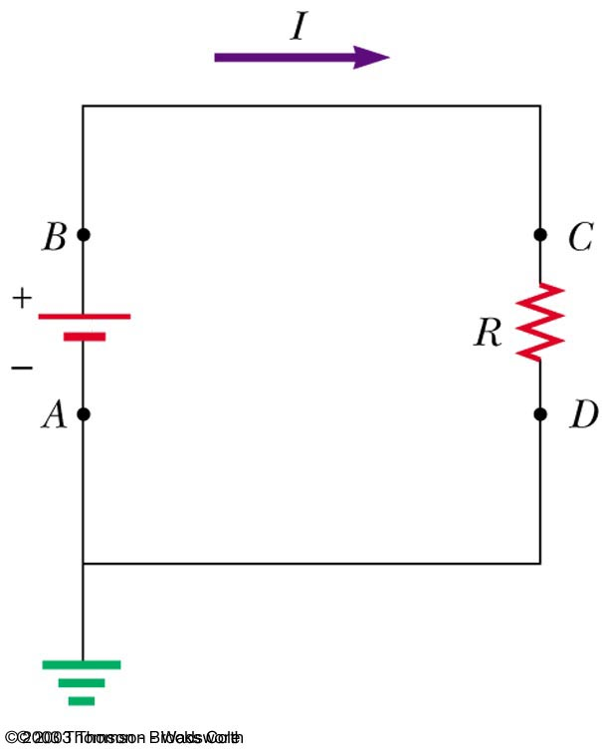
DC Circuits: Review
Current: The rate of flow of electric charge past a point in a circuit
  Measured in amperes (A)
  1 A = 1 C/s = 6.25 × 10¹⁸ electrons per second
  Current direction taken as direction positive charges flow
  Analogous to volume flow rate (volume/unit time) of water in a pipe
Voltage: Electrical potential energy per unit charge
  Measured in volts (V): 1 V = 1 J/C
  Ground is the 0 V reference point, indicated by symbol
  Analogous to water pressure
Resistance: Restriction to charge flow
  Measured in ohms (Ω)
  Analogous to obstacles that restrict water flow

Slide 2
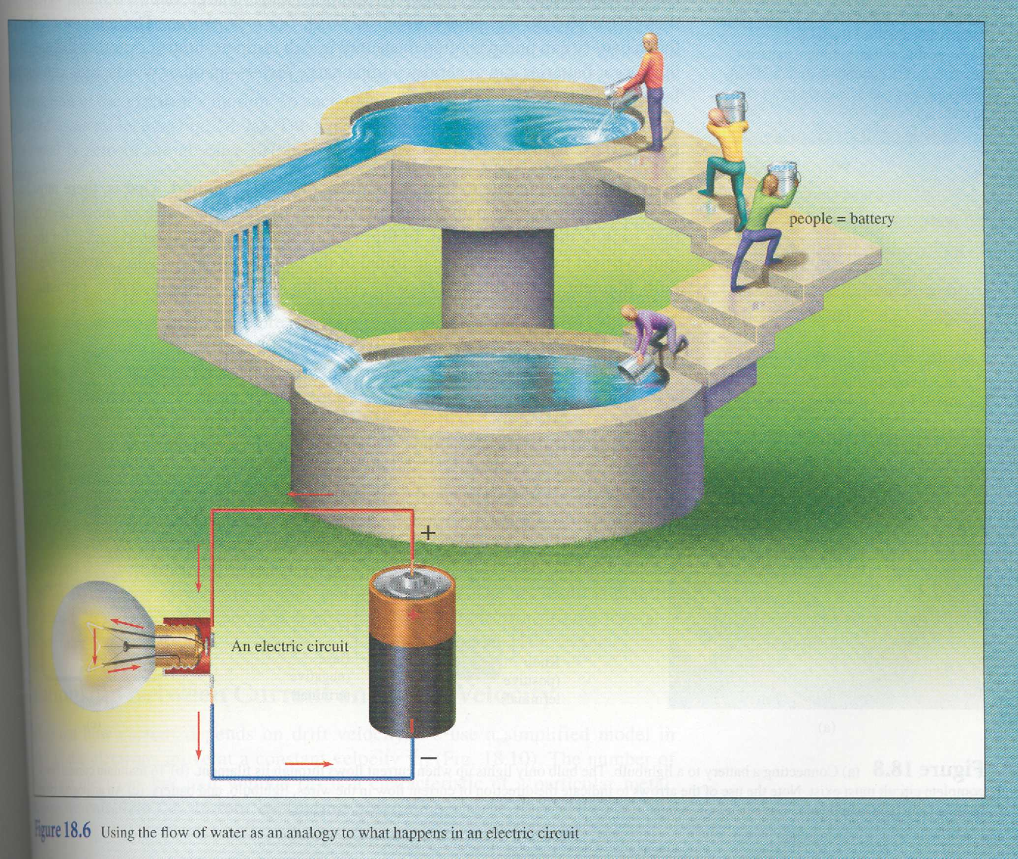
A Helpful Hydraulic Analogy
College Physics, Giambattista

Slide 3
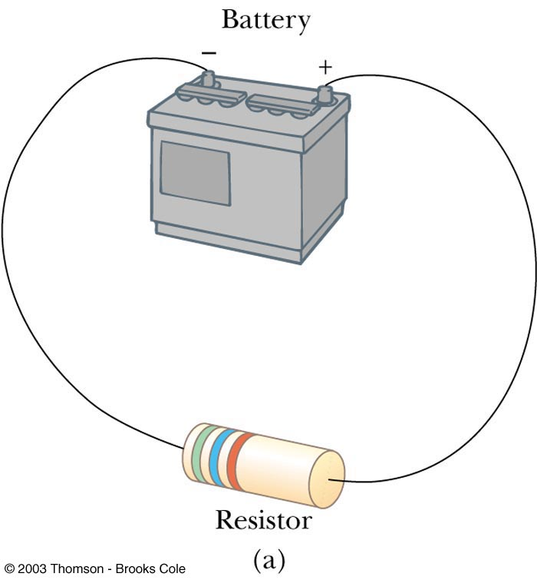

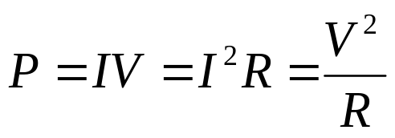
A Simple DC Circuit
(Lab 1–1)
Resistors have a constant resistance over a broad range of voltages and currents
  Then with R = constant (Ohm’s law)
Power = rate energy is delivered to the resistor = rate energy is dissipated by the resistor
V
V

Slide 4
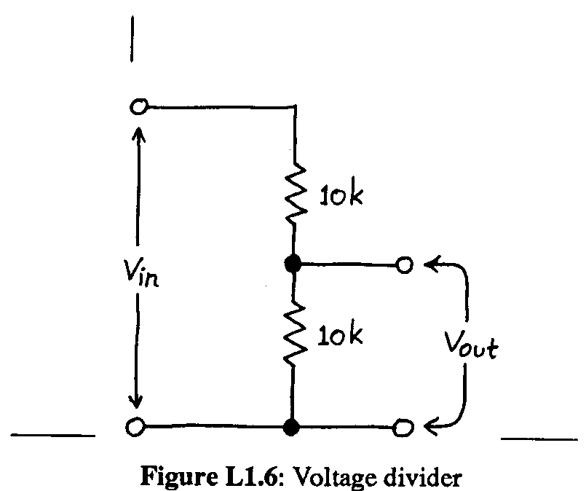
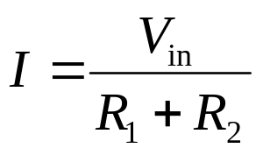
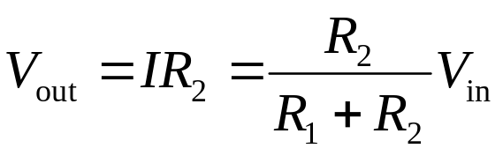
Voltage Divider
(Lab 1–4, 1–6)
Voltage divider: Circuit that produces a predictable fraction of the input voltage as the output voltage
Schematic:
Current (same everywhere) is:
Output voltage (V_{out}) is then given by:
(Student Manual for The Art of Electronics, Hayes and Horowitz, 2nd Ed.)
R₁
R₂

Slide 5
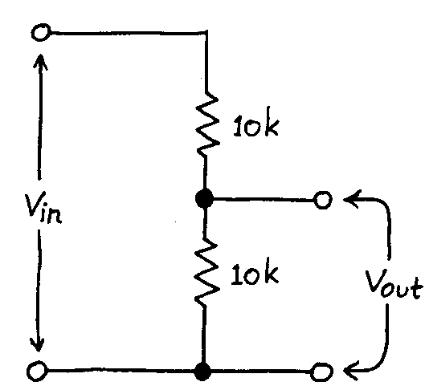

Voltage Divider
Easier way to calculate V_{out}: Notice the voltage drops are proportional to the resistances
  For example, if R₁ = R₂ then V_{out} = V_{in} / 2
  Another example: If R₁ = 4 Ω and R₂ = 6 Ω, then V_{out} = (0.6)V_{in}
Now attach a “load” resistor R_{L} across the output:
  You can model R₂ and R_{L} as one resistor (parallel combination), then calculate V_{out} for this new voltage divider
R₁
R₂
R₁
R₁
=
R₂
R_{L}
R₂ || R_{L}

Slide 6
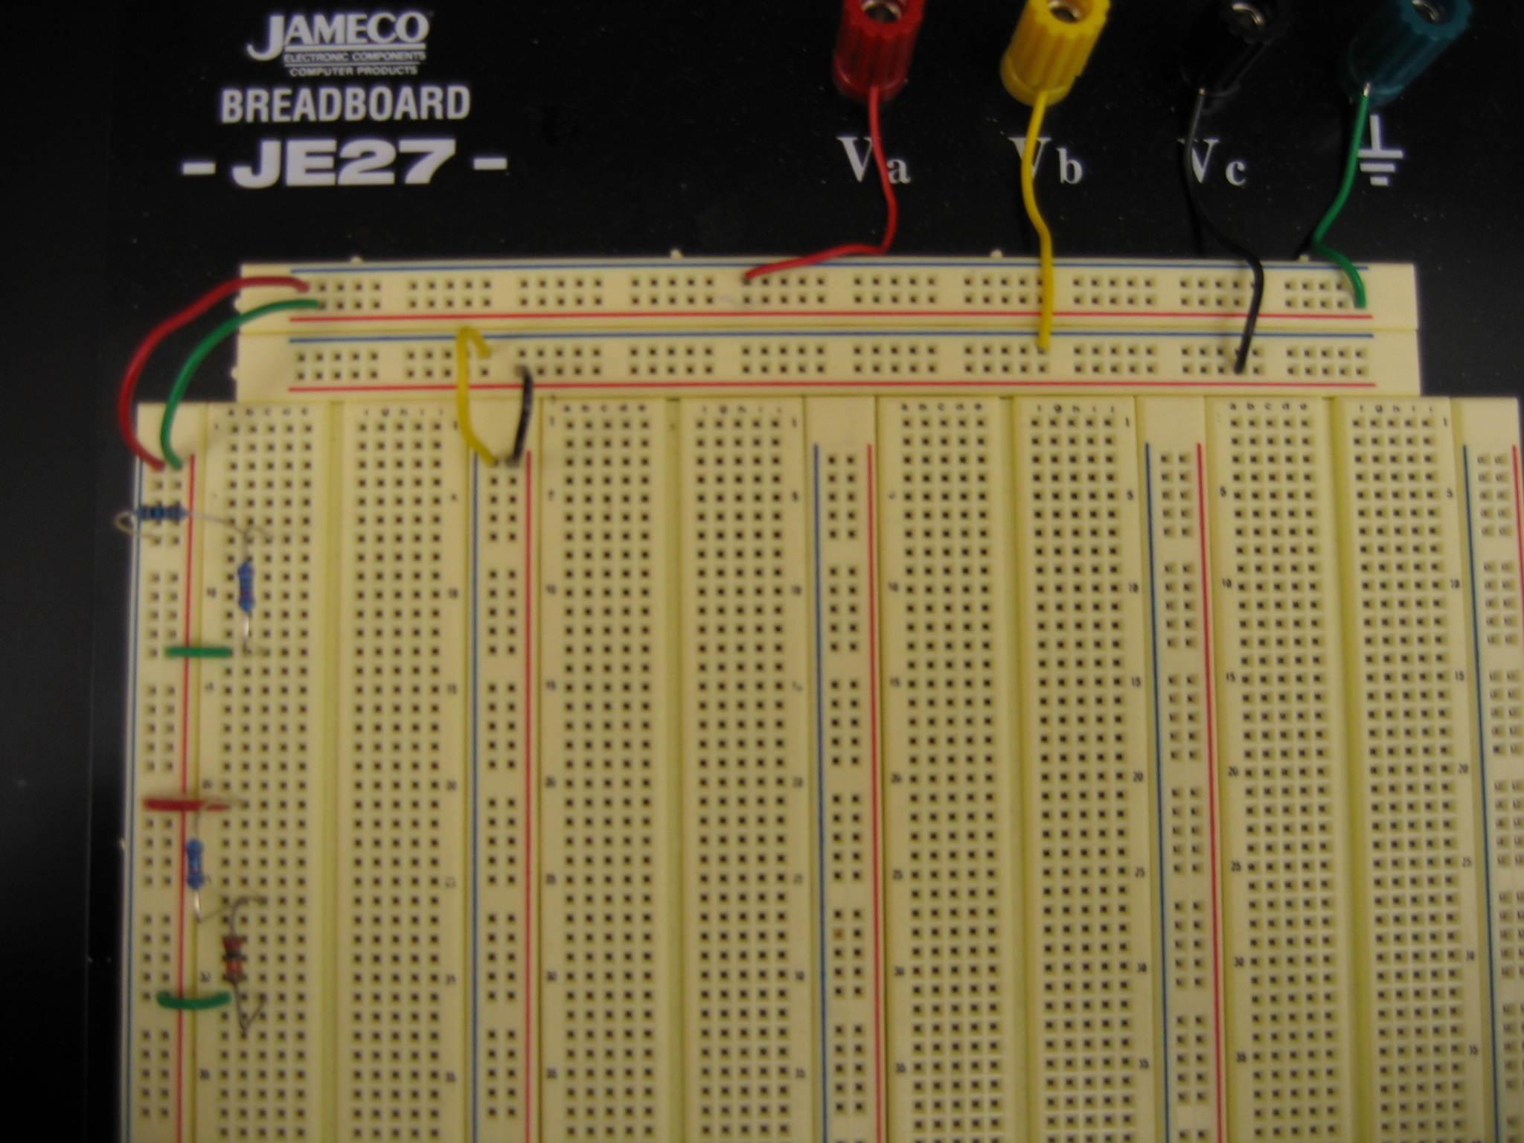
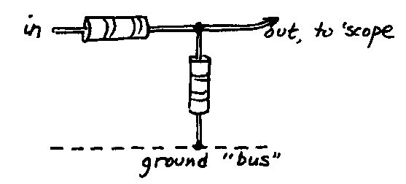
Voltage Dividers on the Breadboard
R₁
V_{in}
V_{out}
R₁
R₂
R₂
R₁
R₁
R₂
R₂

Slide 7
Interactive Example:
Fun With a Loaded Function Generator
Interactive activity performed in class.

Slide 8
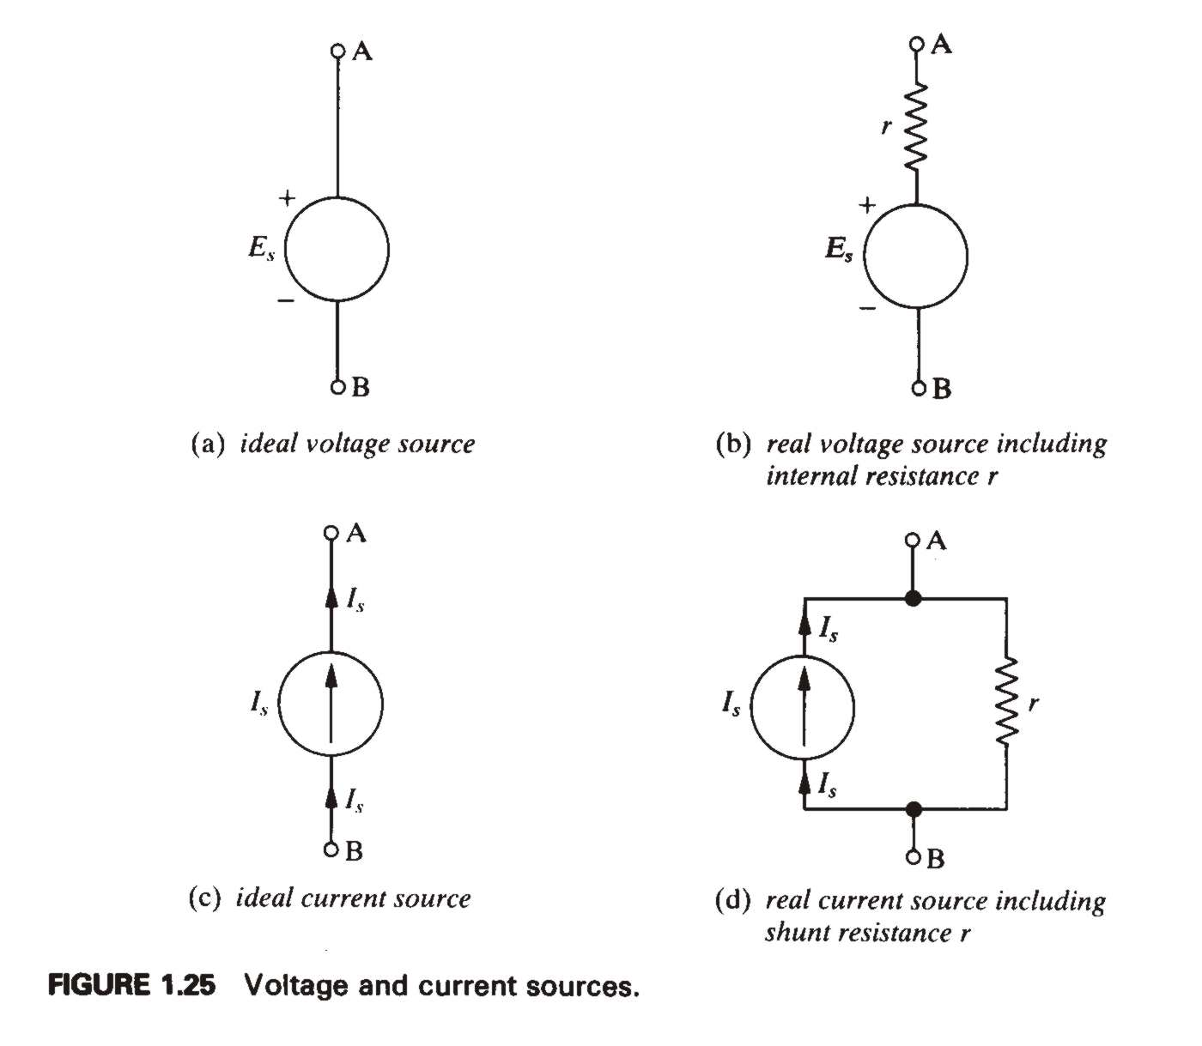
Ideal Voltage and Current Sources
An ideal voltage source is a source of voltage with zero internal resistance (a perfect battery)
  Supply the same voltage regardless of the amount of current drawn from it
An ideal current source supplies a constant current regardless of what load it is connected to
  Has infinite internal resistance
  Transistors can be represented by ideal current sources
(Introductory Electronics, Simpson, 2nd Ed.)

Slide 9
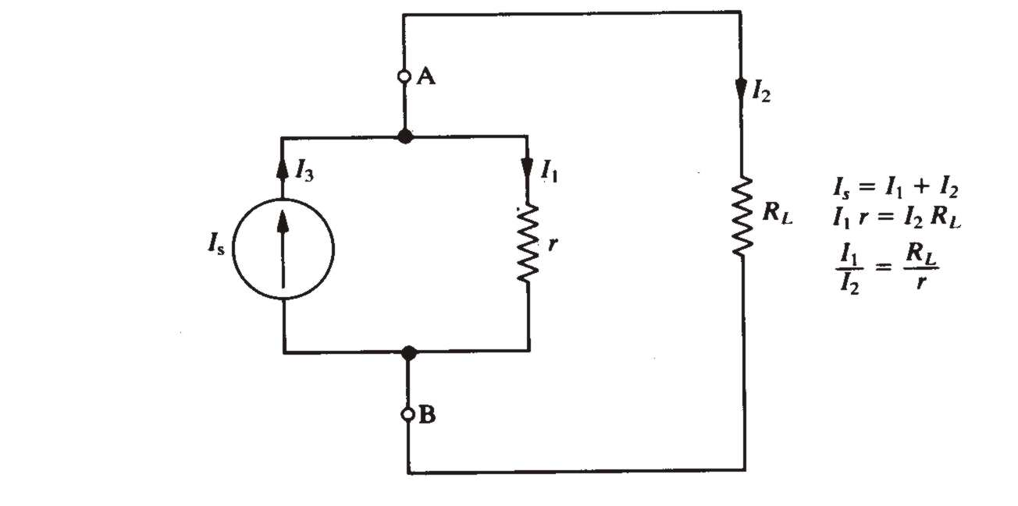
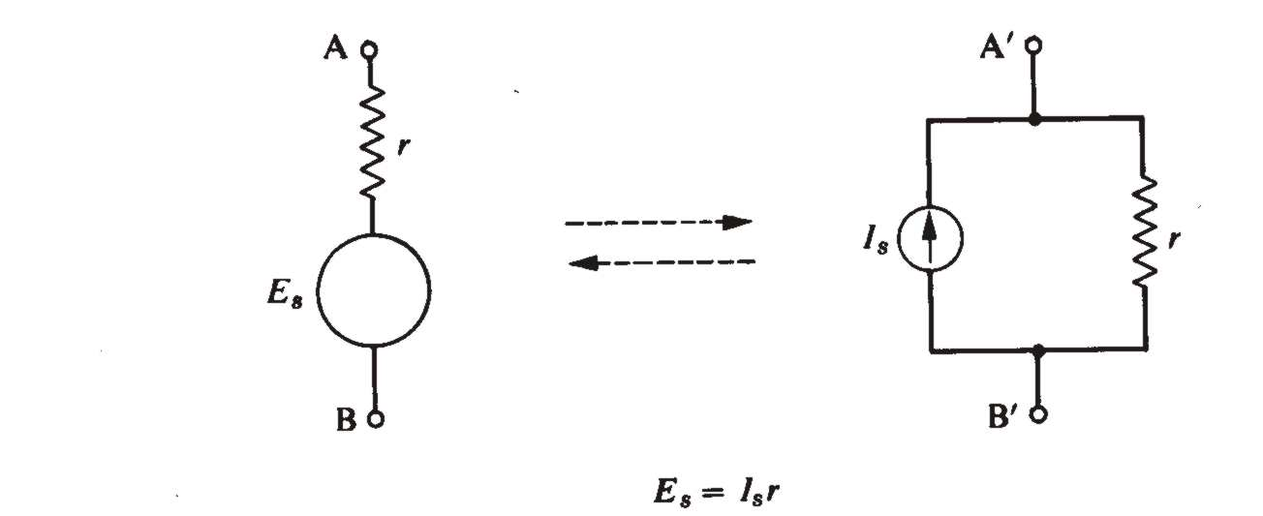
Ideal Voltage and Current Sources
Load resistance R_{L} connected to terminals of a real current source:
  Larger current is through the smaller resistance
Current sources can always be converted to voltage sources
  Terminals A’B’ act electrically exactly like terminals AB
(Introductory Electronics, Simpson, 2nd Ed.)
(Introductory Electronics, Simpson, 2nd Ed.)

Slide 10
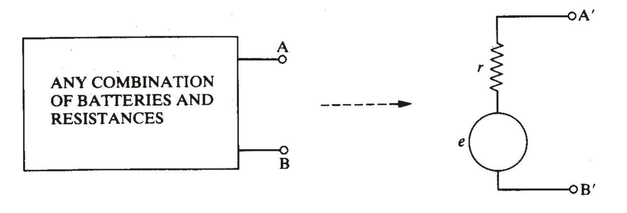

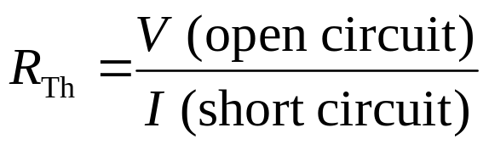
Thevenin’s Theorem
Thevenin’s Theorem: Any combination of voltage sources and resistors with 2 terminals is electrically equivalent to an ideal voltage source in series with a single resistor
  Terminals A’B’ electrically equivalent to terminals AB
Thevenin equivalent V_{Th} and R_{Th} given by:
R_{Th}
(Introductory Electronics, Simpson, 2nd Ed.)
V_{Th}
(output voltage with no load attached)
I (short circuit) = current when the output is shorted directly to ground

Slide 11
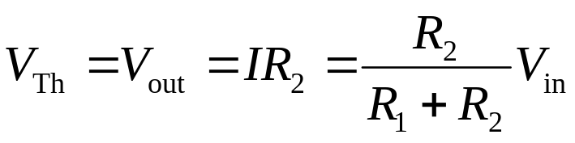
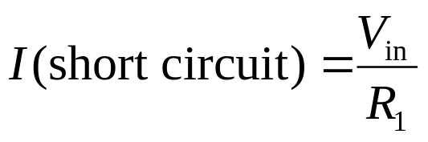
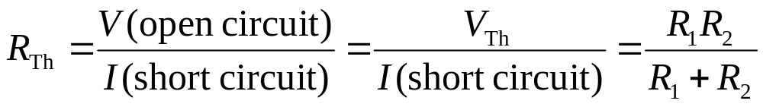
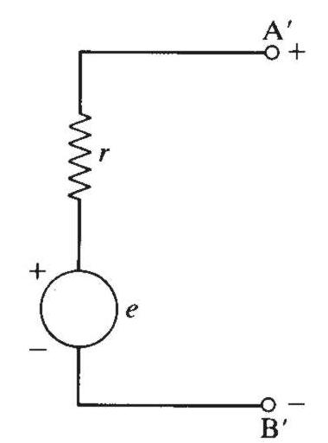
Thevenin’s Theorem
(Lab 1–4)
Thevenin’s theorem applied to a voltage divider:
Thevenin equivalent circuit:
  Note that R_{Th} = R₁ || R₂
    Imagine mentally shorting out the voltage source
    Then R₁ is in parallel with R₂
    R_{Th} is called the output impedance (Z_{out}) of the voltage divider
R₁
R₂
R_{Th}
(a load resistance R_{L} can then be attached between terminals A’ and B’, in series with R_{Th})
(Introductory Electronics, Simpson, 2nd Ed.)
V_{Th}

Slide 12
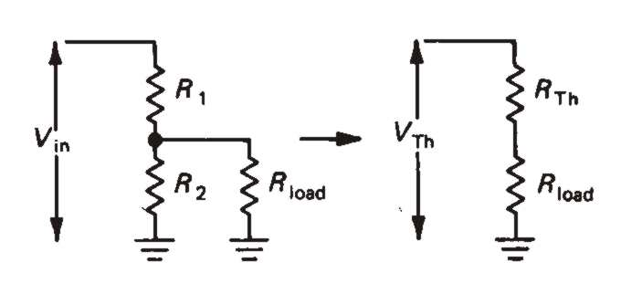
Example Problem #1.9
(The Art of Electronics, Horowitz and Hill, 2nd Ed.)
For the circuit shown, with V_{in} = 30 V and R₁ = R₂ = 10k, find (a) the output voltage with no load attached (the open-circuit voltage); (b) the output voltage with a 10k load; (c) the Thevenin equivalent circuit; (d) the same as in part b, but using the Thevenin equivalent circuit (the answer should agree with the result in part b); (e) the power dissipated in each of the resistors.
Solution (details given in class):
15 V
10 V
V_{Th} = 15 V, R_{Th} = 5k
10 V
P_{L} = 0.01 W, P_{R2} = 0.01 W, P_{R1} = 0.04 W

Slide 13
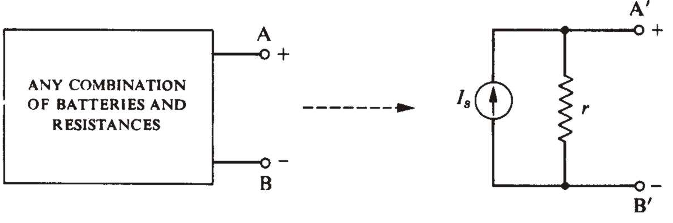
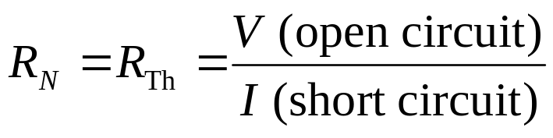
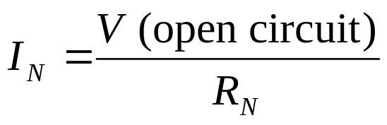
Norton’s Theorem
(see AE 1)
Norton’s Theorem: Any combination of voltage sources and resistors with 2 terminals is electrically equivalent to an ideal current source in parallel with a single resistor
  Terminals A’B’ electrically equivalent to terminals AB
Norton equivalent I_{N} and R_{N} given by:
(Introductory Electronics, Simpson, 2nd Ed.)
I_{N}
R_{N}
(same as Thevenin equivalent resistance)
(same as I (short circuit))

Slide 14
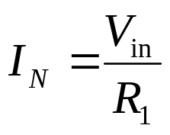
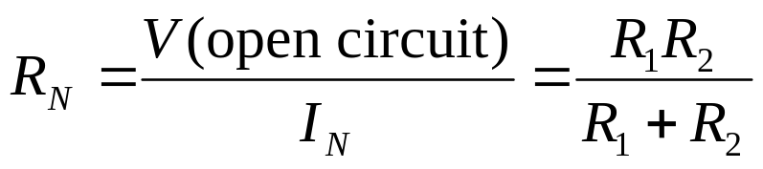
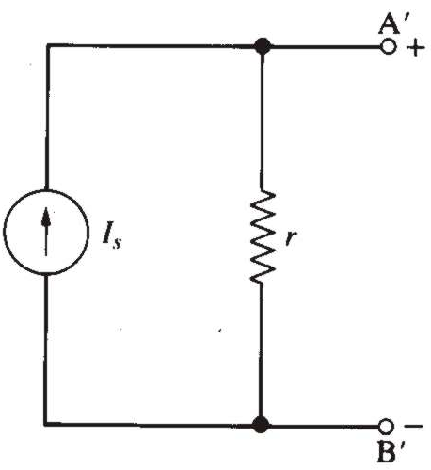
Norton’s Theorem
Norton’s theorem applied to a voltage divider:
Norton equivalent circuit:
  The Norton equivalent circuit is just as good as the Thevenin equivalent circuit, and vice versa
R₁
R₂
(a load resistance R_{L} can then be attached between terminals A’ and B’, in parallel with R_{N})
(Introductory Electronics, Simpson, 2nd Ed.)
I_{N}
R_{N}

Slide 15
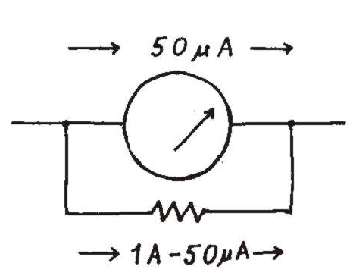
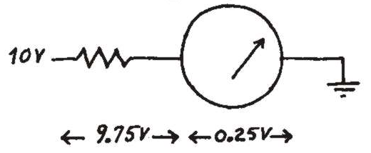
Example Problem #1.7
(similar to HW Problem #1.8)
Ammeter
What will a 20,000 Ω/V meter read, on its 1 V scale, when attached to a 1 V source with an internal resistance of 10k? What will it read when attached to a 10k–10k voltage divider driven by a “stiff” (zero source resistance) 1 V source?
Solution (details given in class):
1–V source: 0.667 V
10k–10k voltage divider: 0.4 V
Voltmeter

